Slide 1


Slide 2


Slide 3
Building a Multi-Platform App

Slide 4
Types of Mobile Apps
Html5
Native
Hybrid
Which is the best for you?

Slide 5
Html5 Apps
Written in: Javascript, HTML
Styled with: CSS
Run in: Web Browser
Disadvantage: Very limited native components
Advantage: Cheap to develop

Slide 6

“When I'm introspective about the last few years, I think the biggest mistake that we made as a company is betting too much on HTML5 as opposed to native.
It's not that HTML5 is bad. I'm actually, long-term, really excited about it.”
—

Slide 7

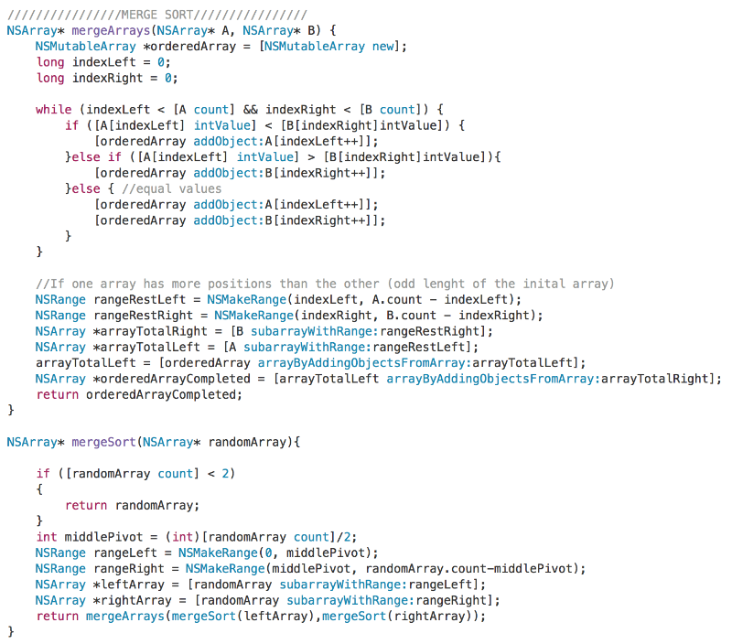
Native Apps
Writen in: Objective-C, Swift, Java
Styled with: UIKit
Native Components
Advantage: Performance, Native feel, App Store
Disadvantage: Expensive, Objective-c

Slide 8
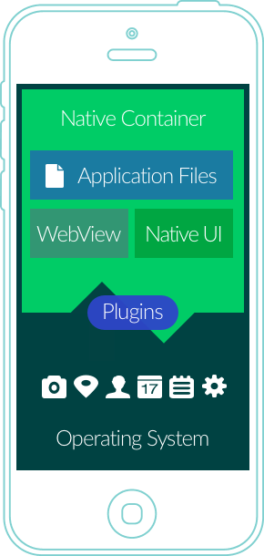
Hybrid Apps
Written in:JavaScript, HTML, etc.
Styled with: CSS
Run in: WebView
Advantage: app store accelerometer, camera, contacts, cheap-ish
Disadvantage: Performance, constantly fighting small differences between iOS/Android

Slide 9
Popular Frameworks
Framework | Language | Implementation
React Native | JavaScript | Native components
Ionic | JavaScript | webview
Cordova | JavaScript | webview
Xamarin | c# | Native Components

Slide 10
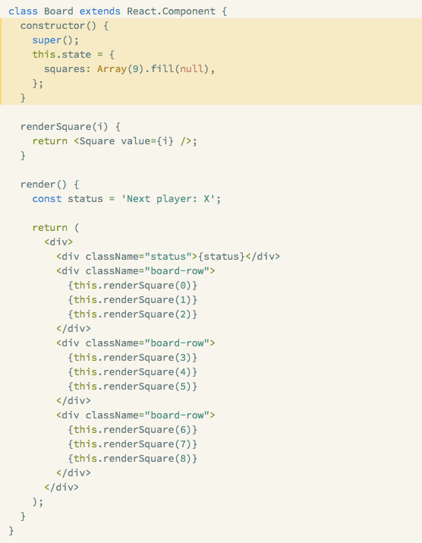
React
Backed by Facebook
Open sourced in 2013
“Learn Once, write anywhere” (a play off write once, run anywhere)
Focuses on components
setState is the best thing ever
JSX

Slide 11
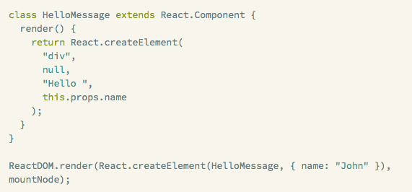
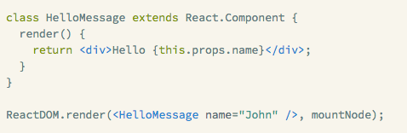
JSX

Slide 12
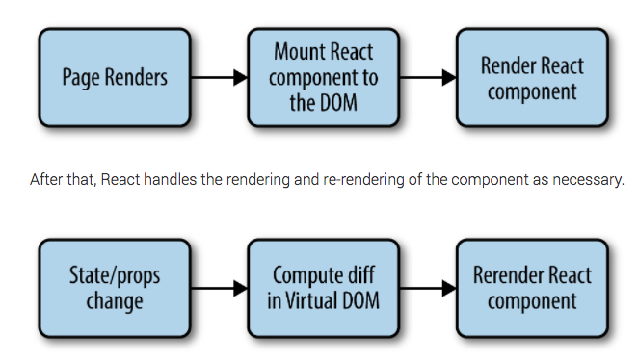
Component Lifecycle

Slide 13
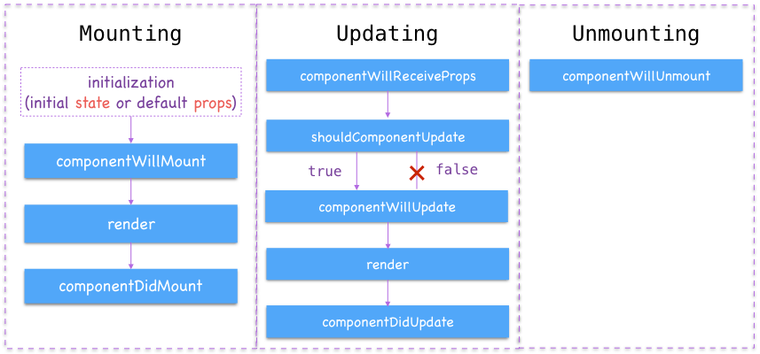
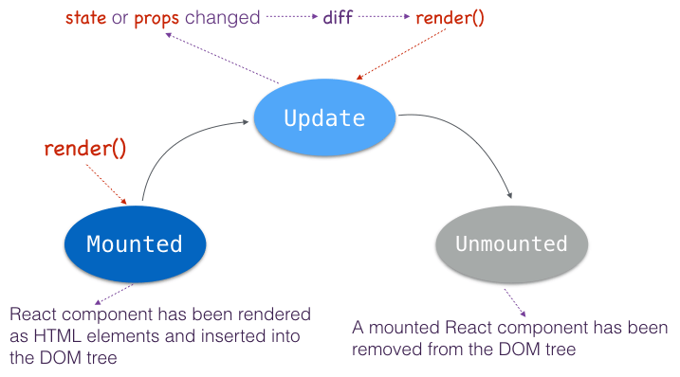
Component lifecycle (cont)

Slide 14
React Native
Open Sourced in 2015
Real native app
Written in javascript
“With React Native you don't build a “mobile web app”, an “HTML5 app”, or a “hybrid app”. You build a real mobile app that's indistinguishable from an app built using Objective-C or Java”

Slide 15
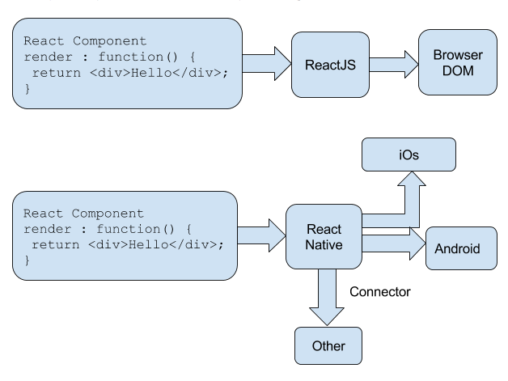
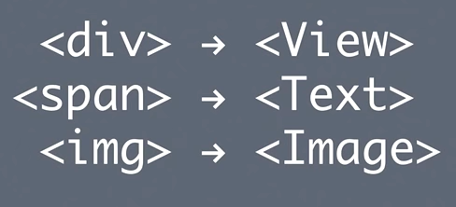

Slide 16
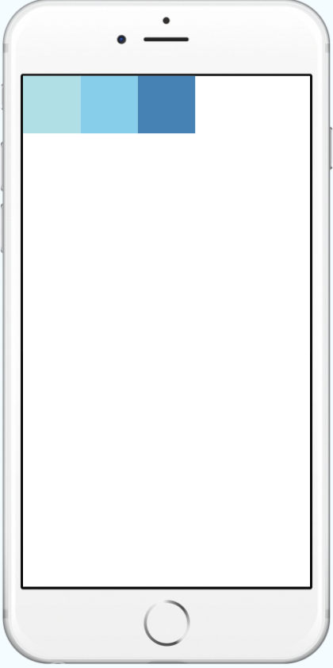

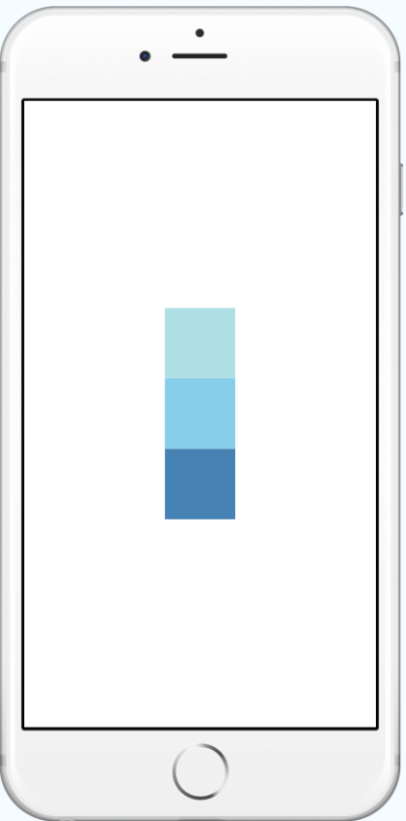
Styling in React Native

Slide 17
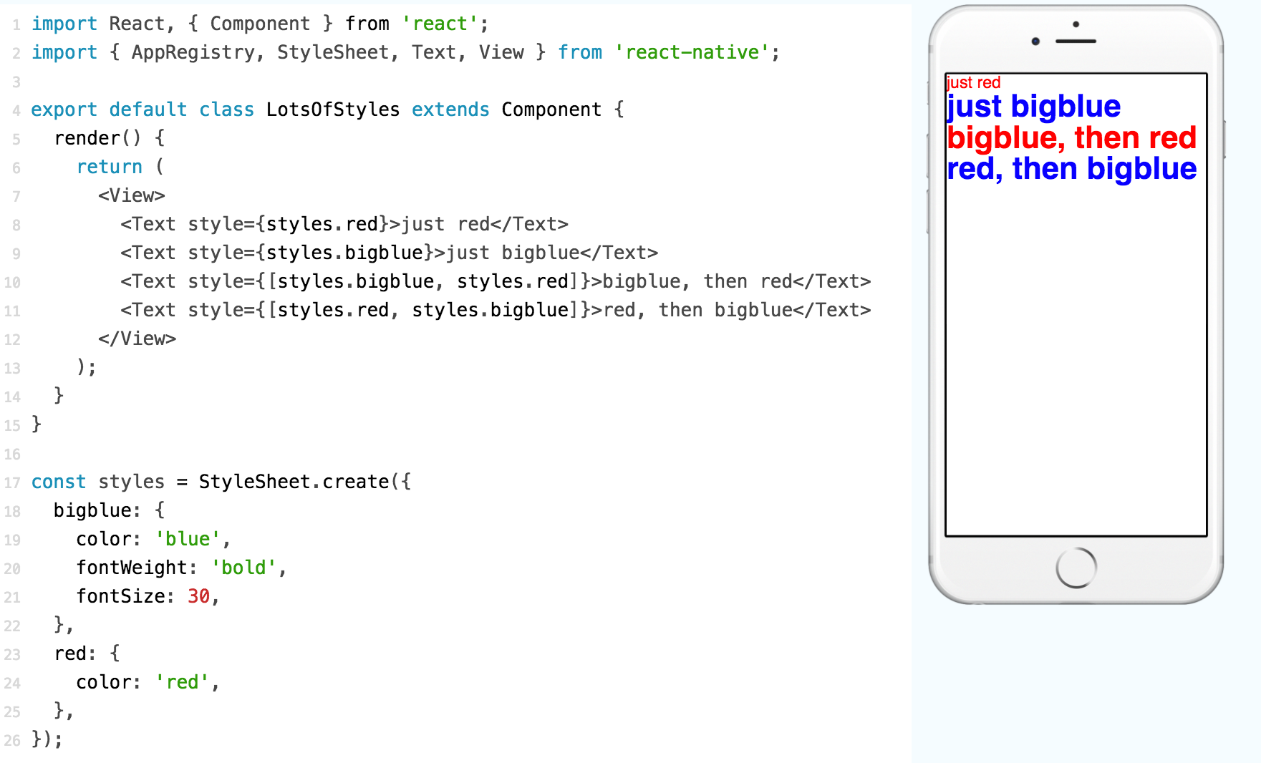

Slide 18
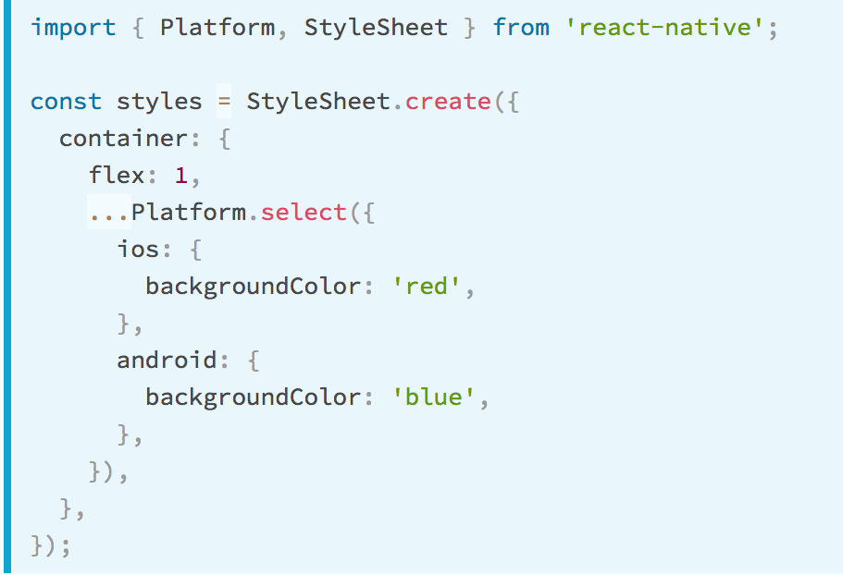
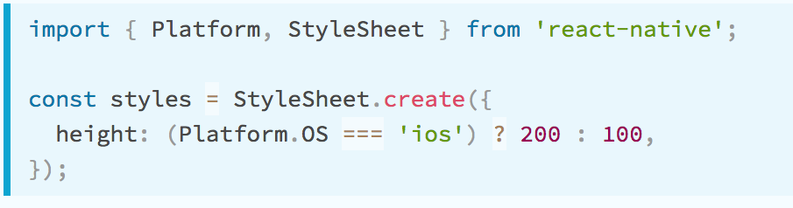
Platform Specific controls

Slide 19
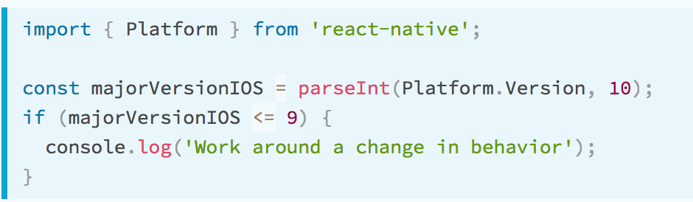
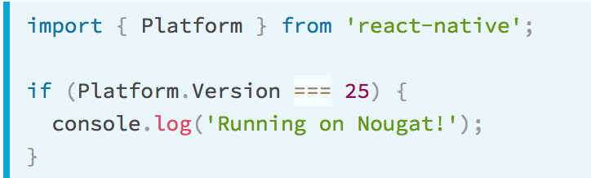
Platform Version

Slide 20
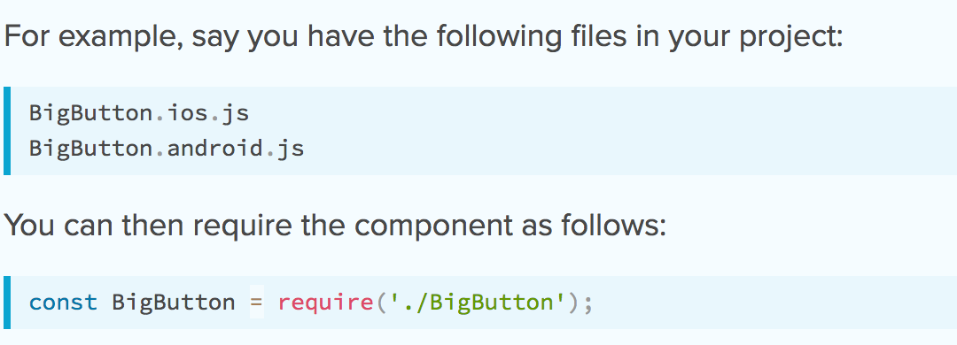
Platform Specific controls (cont)

Slide 21
Demo
http://www.reactnative.com/uiexplorer/

Slide 22
reactnative.com
http://facebook.github.io/react-native
Resources

Slide 23
Thank you

